Slide 1

Varray & table collections
Sunday Onwuchekwa and Antonio Cadena

Slide 2
TABLE COLLECTIONS
Our textbook defines table collection as single-dimensional structures that have no limit on the number of elements that they hold.
The two types of table collections are:
Scalar Table Collections: These are created over a scalar data type like a number, varchar2, date, etc.
Composite Table Collections: These are created over composite data types like records, objects and another nested table itself.
A table collection is declared with this command:
The words I underlined are keywords that must be used. The NOT NULL is optional when declaring scalar type of table collections.
TYPE <Type_name> IS TABLE OF <Scalar_datatype [NOT NULL] | Composite_datatype>;

Slide 3

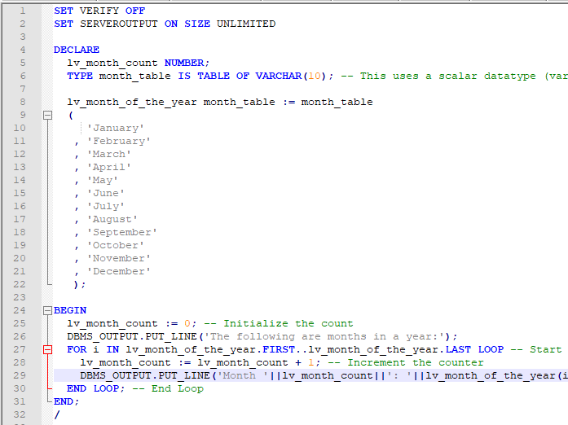
EXAMPLES OF SCALAR TABLE COLLECTIONS

Slide 4
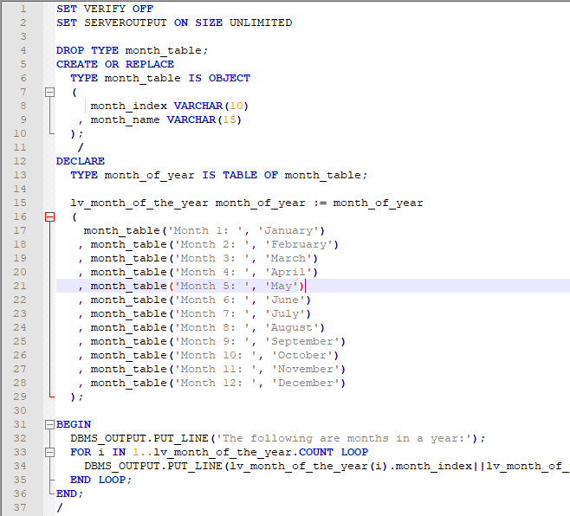
EXAMPLES OF COMPOSITE TABLE COLLECTIONS

Slide 5
Varrays
Varrays = Variable size array
Have a set number of elements when created or declared
Elements have the same data type
They are no gaps between each elements meaning its densely packed
Index1
Element
Index 2
Element
Index 3
Element
Index 4
Element
Index 5
Element
Index 6
Element
VARCHAR2
VARCHAR2
VARCHAR2
VARCHAR2
VARCHAR2
VARCHAR2

Slide 6
Varray METHODS
EXTEND increases the varray index by 1
TRIM removes an element. (DELETE does not work on varrays)
FIRST and LAST allows you to locate the first or last element in the array
NEXT and PRIOR allows you move to the next or prior element.
COUNT counts the number of elements in the varray

Slide 7
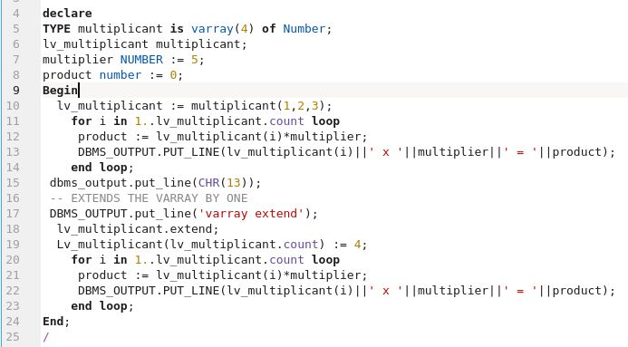
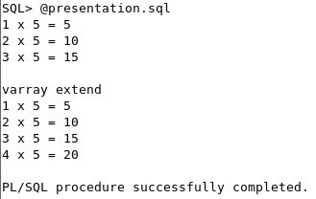
Varray example code

Slide 8
THANK YOU

